Slide 1
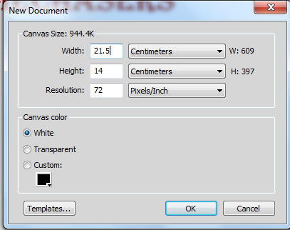
This is a screenshot of the size of the document on Adobe Fireworks. I did it this particular size because the exam brief said it needs to be 215 mm wide x 140 mm high.
Fireworks didn’t have the option to put the width and height into mm, so I converted it into cm.

Slide 2
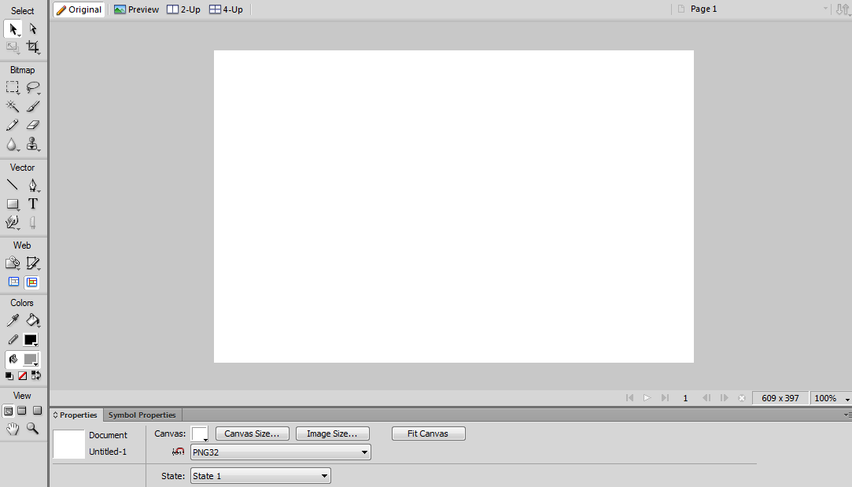
This is the size of the template that I created my magazine advert on.

Slide 3
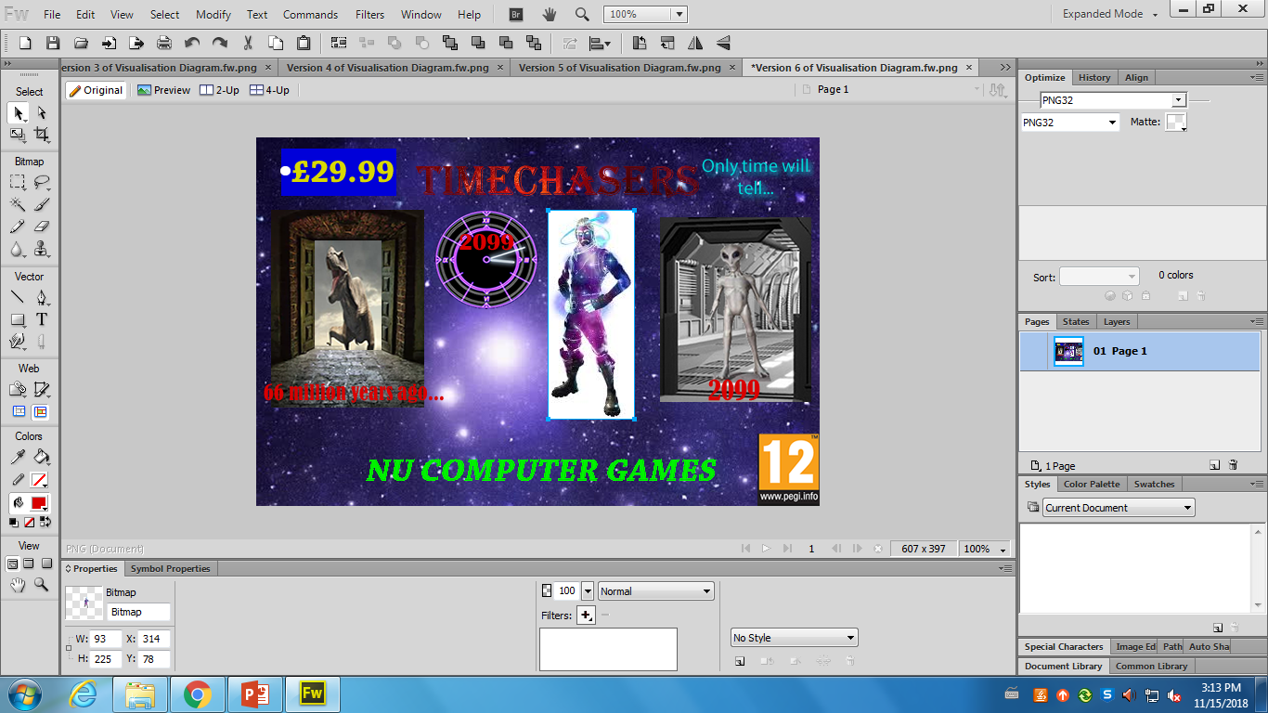
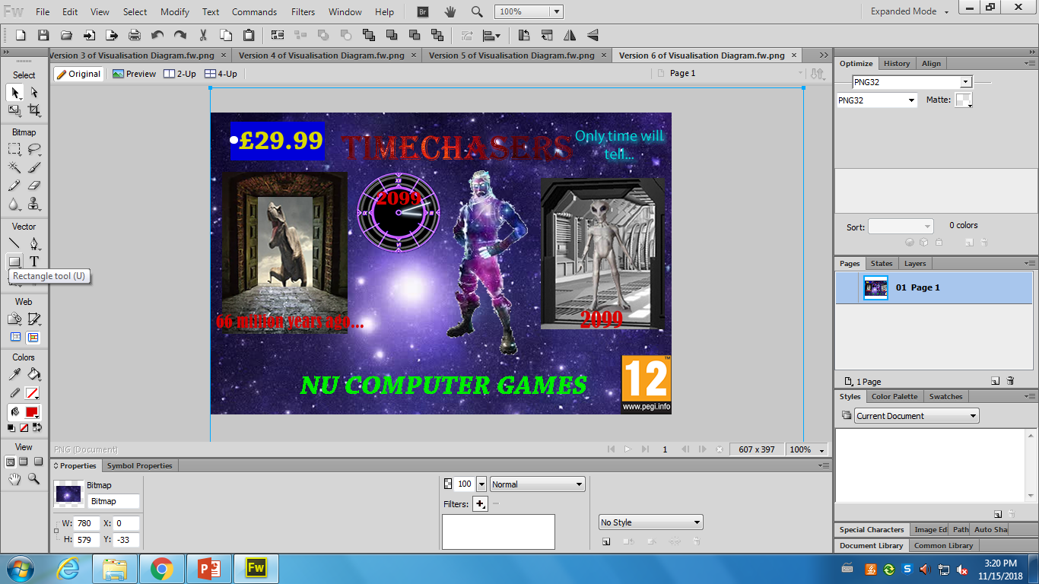
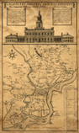
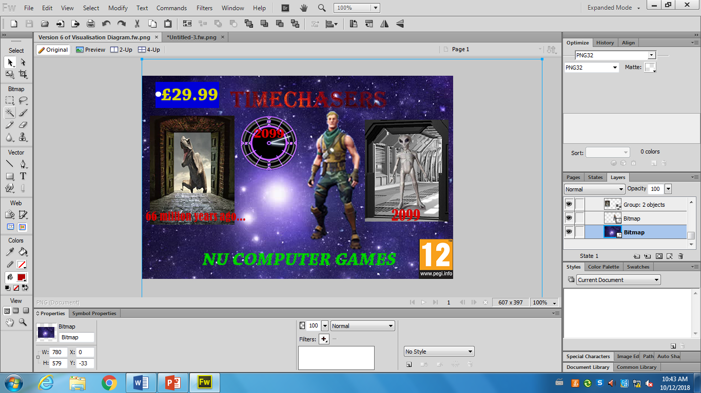
The character I wanted had a white background on it and I wanted to get rid of it as my background colour is blue, so I used the Magic Wand tool to take the white out so I could use that character.
This is the main character of my game. The client brief mentions I needed to have a main character in the magazine advert.

Slide 4
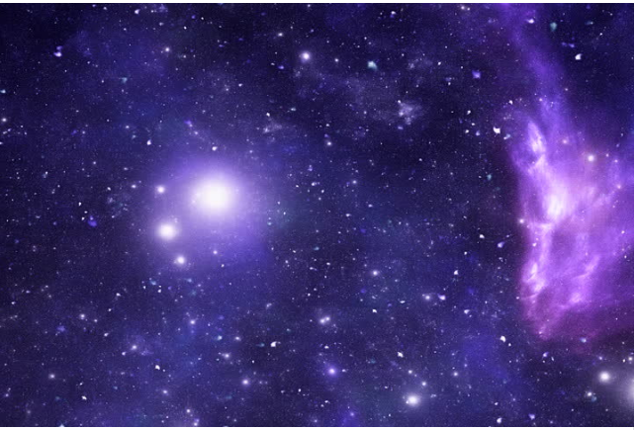
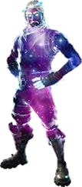
This is the background for my magazine advert. I chose this as this looks futuristic and relates to the topic of time travel. Furthermore, this looks really good with my character, which is purple and has a similar colour to this picture.
I copied this image from the internet and pasted it to Fireworks.
My character looks like the background of the advert, so this is mostly why I chose this background. The glow makes them look similar as both pictures have a glow to it.

Slide 5
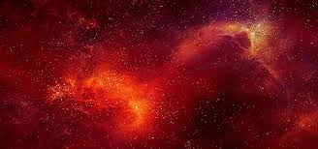
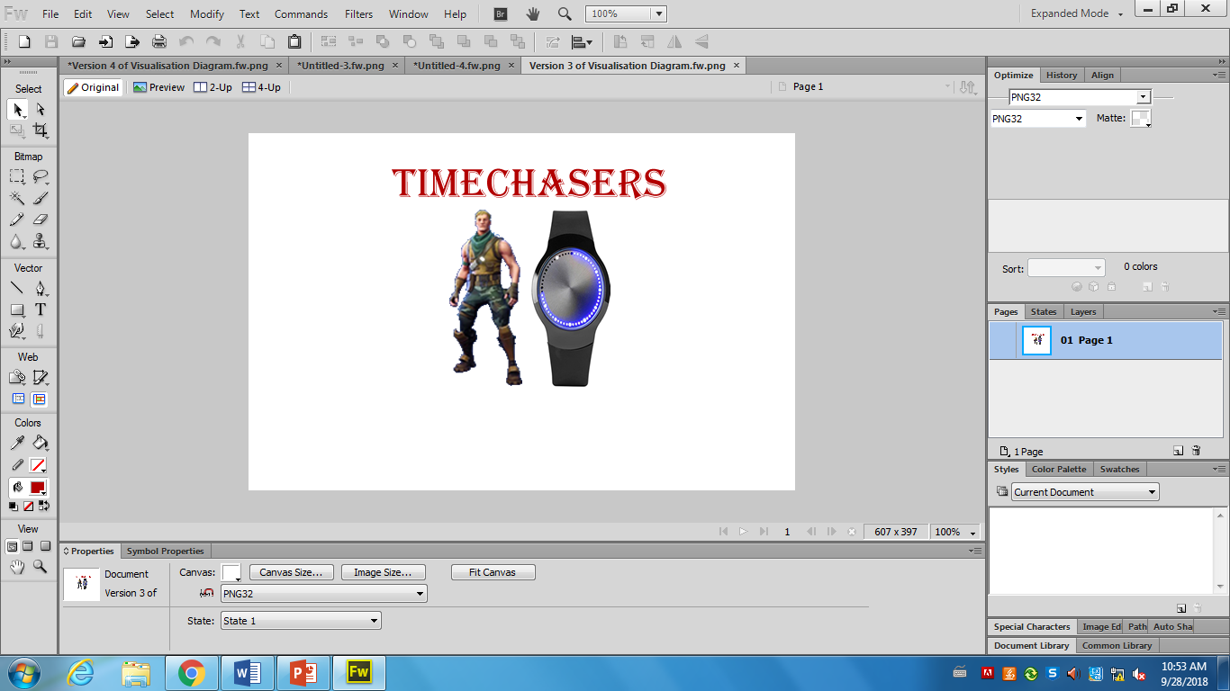
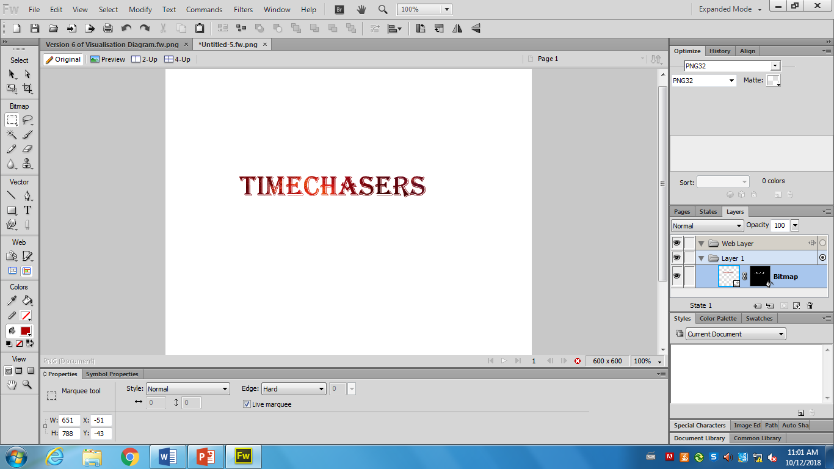
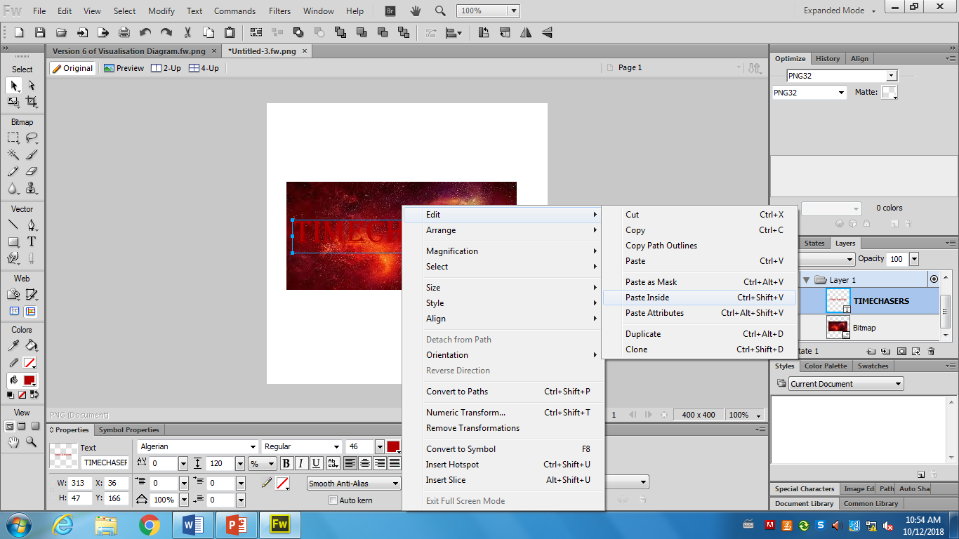
The ‘TIMECHASERS’ title looked quite plain in my opinion so I changed it. I did this by getting a nice background and put it over the ‘TIMECHASERS’ text so the background was in the text.
How I did it:
I right-clicked on the mouse.
Clicked Edit
Then Paste Inside
This allowed the background to go inside the text (as shown above). As a result, it looked nice and eye-catching.

Slide 6
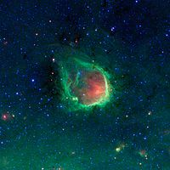
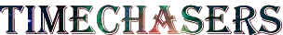
This is what the text looked like with that background in.
This WAS my background for the text but I decided to change it because I found a better looking one on the internet.

Slide 7
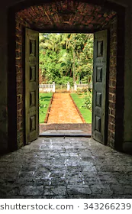
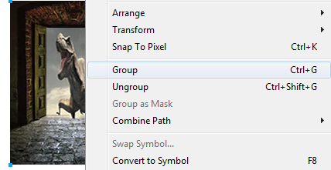
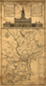

Here, I wanted to group the map and the door together. So to do this, I put the map picture inside the door (on the right) and grouped the two pictures together using the group tool.

Slide 8

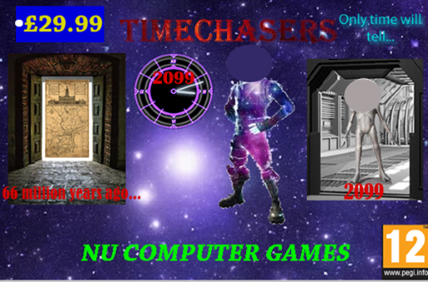
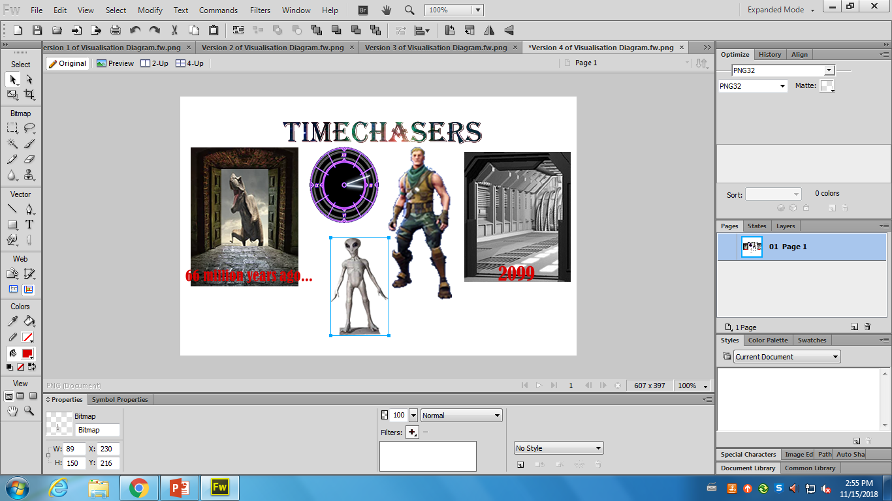


I opened a new tab and copied this headless image. I also cropped it using the crop tool to remove the unnecessary white background.
I also used the magic wand tool to take the inside white parts out.

Slide 9
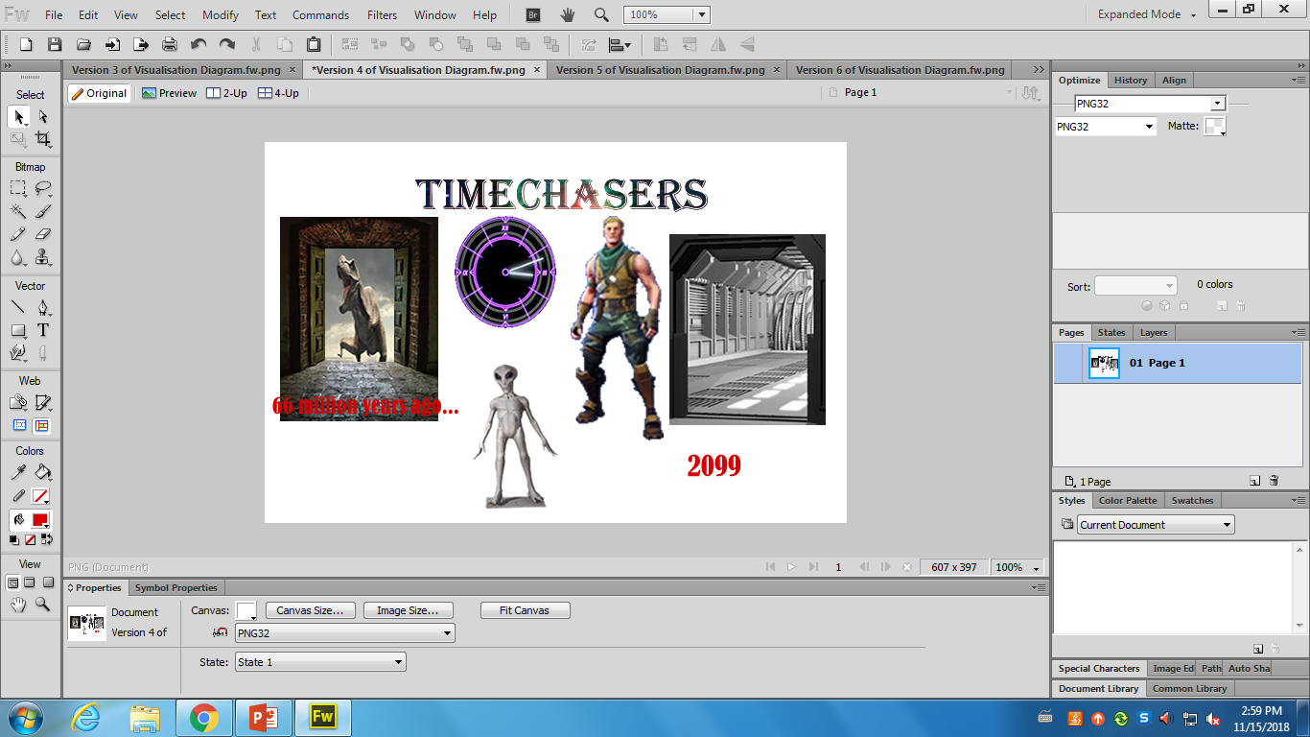
I then got this picture and added the 2099 text. Then I grouped them together by selecting them both and clicked ‘Group’.

Slide 10
This is the end result.

Slide 11
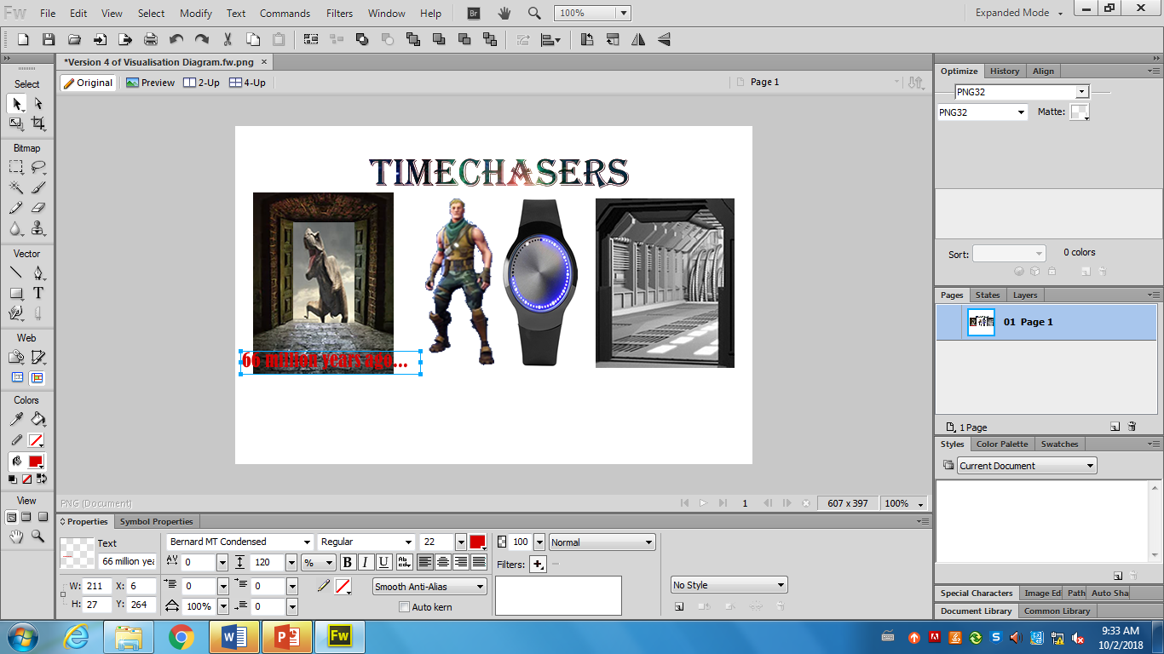
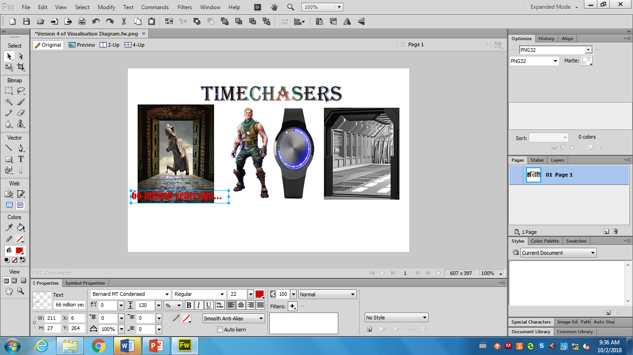
For the texts, I used the Bernard MT Condensed font and the red colour. I made the text colour red because it is a bright colour and can be easily seen. I used this particular font as it looks quite eye-catching.

Slide 12
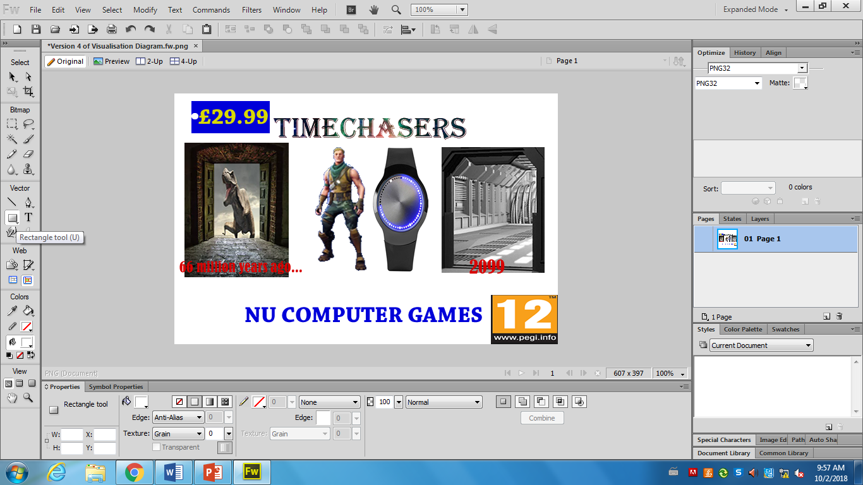

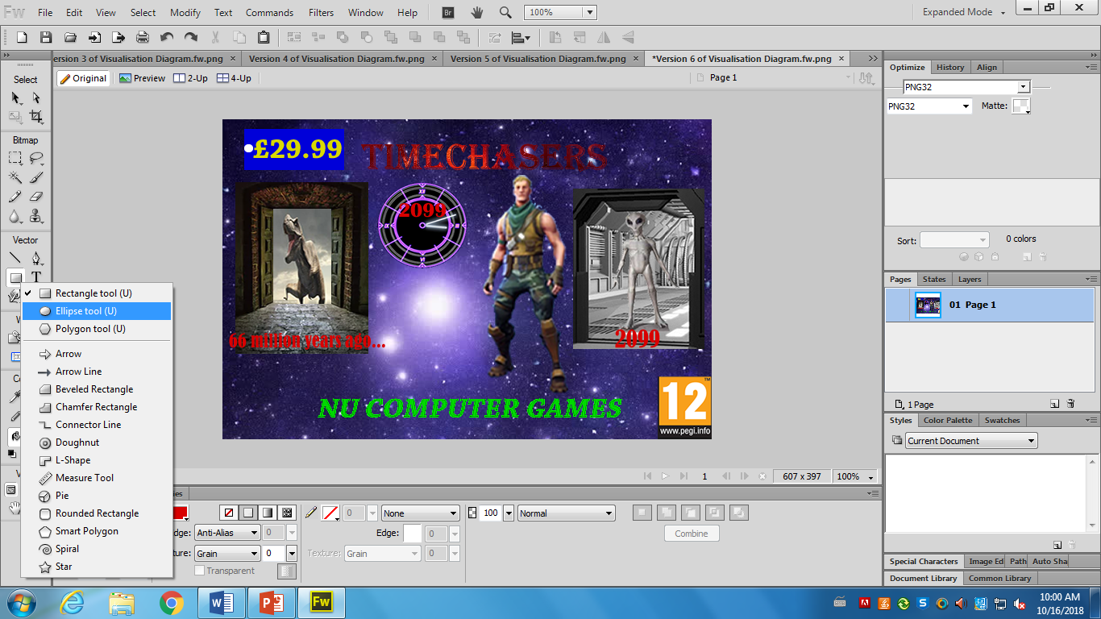
The client brief stated I need to include the price on the magazine cover of £29.99. I intended to use a price tag off the internet, but I decided to make my own one .
I decided to make the price yellow with a blue background as they are vibrant colours and they can be easily seen over the purple background so the viewers can see the price.
To make the price tag, I used the rectangle tool in Fireworks and put £29.99 on it as the client brief stated. I also used the ellipse tool to make a little white circle so it looks more like a price tag.

Slide 13
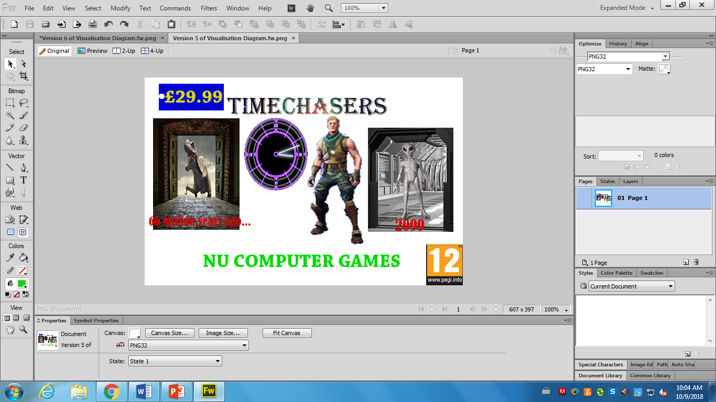
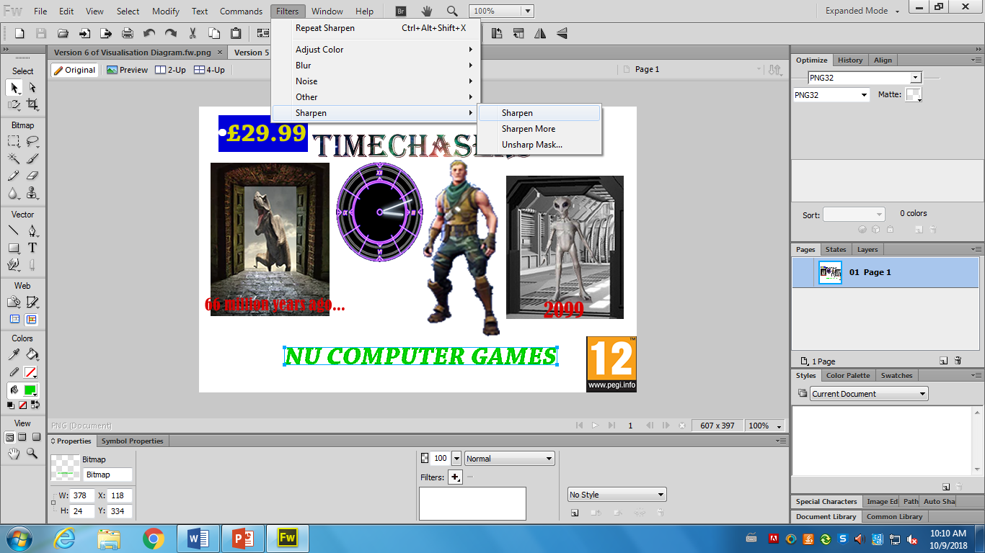

The NU Computer Games logo looked plain so I wanted to change it to make it look eye-catching. To do this, I highlighted the text, went onto Filters, Sharpen. Once I did this, it still looked plain so I repeated it a few times by clicking Sharpen More until I got this.

Slide 14
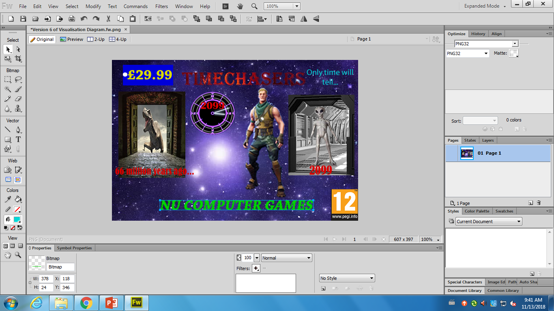
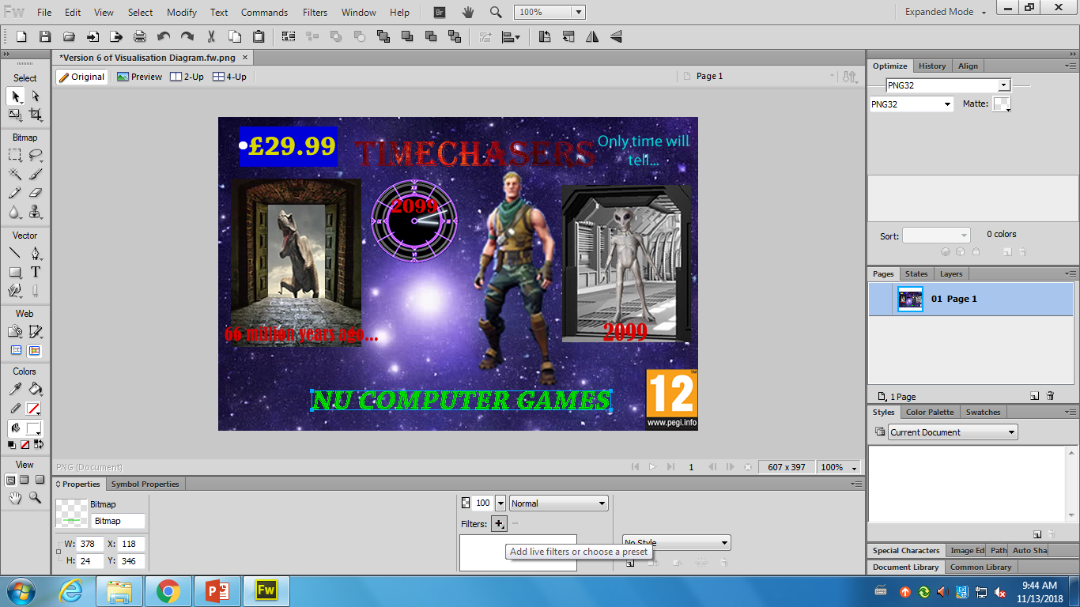
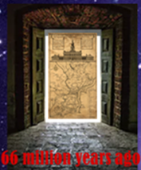
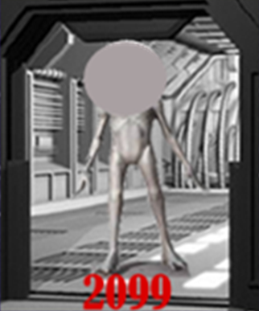
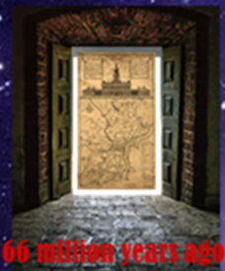
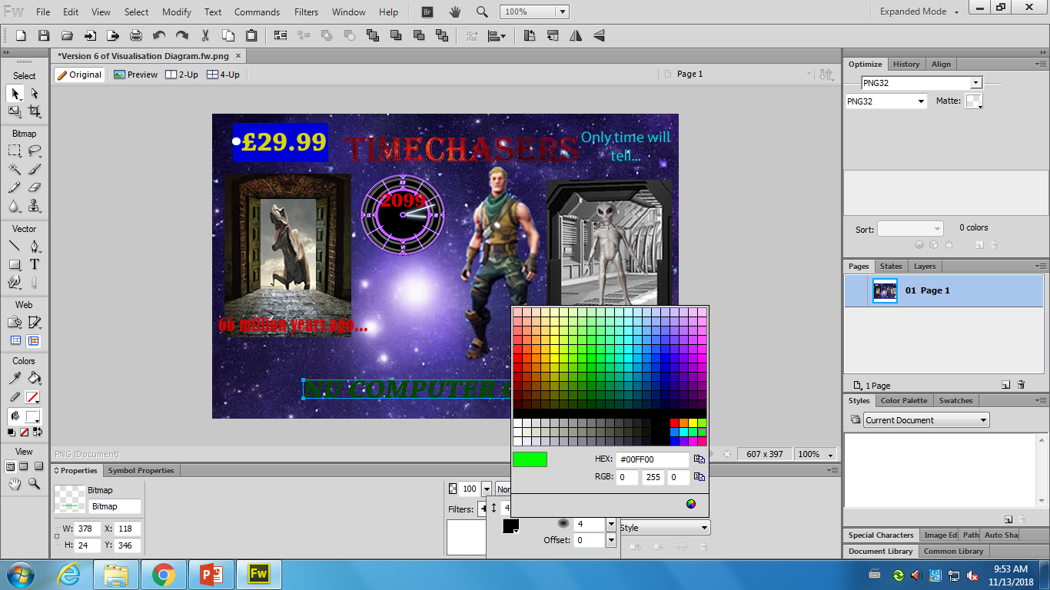
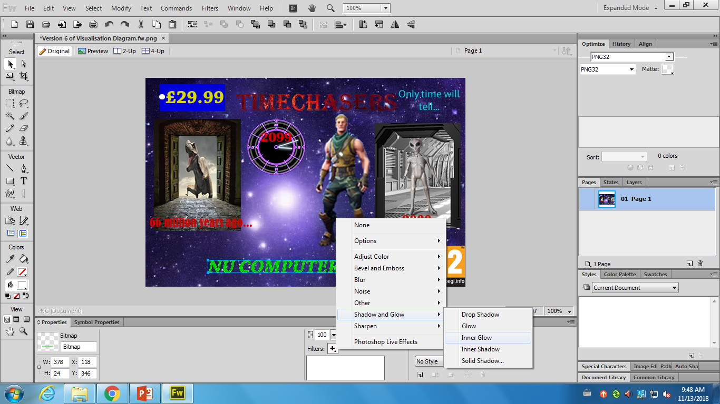
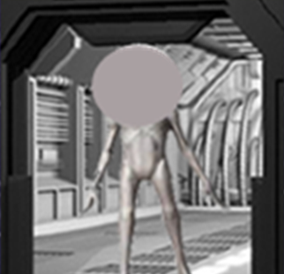

Next, I put a glow on the NU Computer Games
Next, I clicked on the Filters icon at the bottom of the page
First, I highlighted the text
Then I chose to do an inner glow as it looked better
Finally, I changed the glow from a black glow to a green one

Slide 15


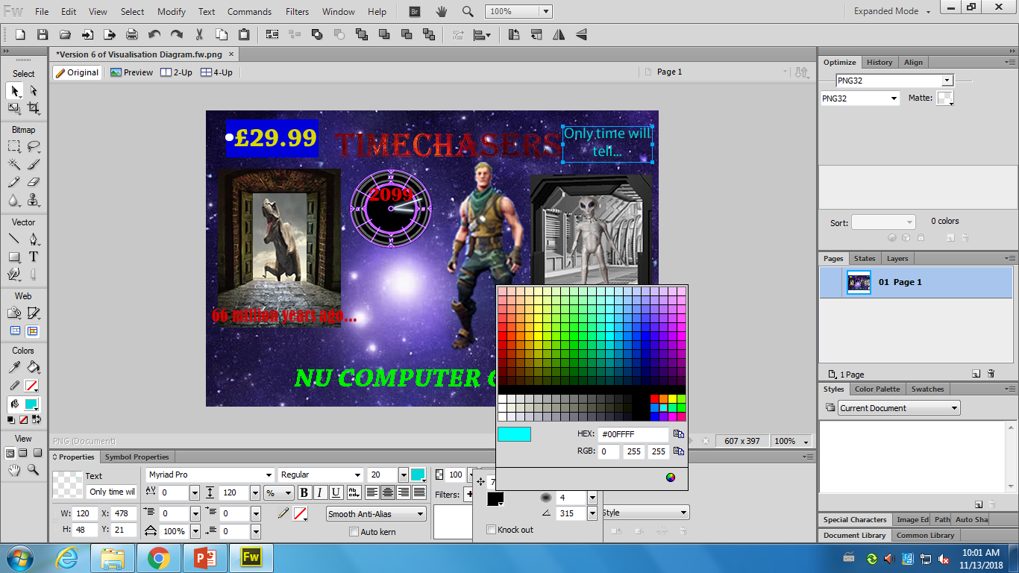

I then put a shadow onto my slogan
Next, I put a drop shadow on the text instead of a glow.
First, I highlighted the text and then clicked on the filters icon again
Then I changed the colour to blue
This is what it looked like at the end

